Slide 1
Lesson 15:
Instabot

Slide 2

AGENDA
Introduction to Web APIs
Instabot Project

Slide 3
Introducing Web APIs
API stands for Application Programming Interface.
In computer programming, an application programming interface (API) is a set of subroutine definitions, protocols, and tools for building software and applications.
To put it in simple terms, an API is a set of methods and tools that can be used for building software applications.

Slide 4
JavaScript Object Notation(JSON)

Slide 5
Introduction to JSON
JSON stands for JavaScript Object Notation.
JSON is a lightweight syntax for data storing and exchanging between server and client.
JSON is "self-describing" and easy to understand.
JSON is language independent *.
JSON is based on key value pairs

Slide 6
Let’s have a look at the piece of a JSON data. It basically has key-value pairs.
var instructor_1 = {
"first_name": "Mohit",
"last_name": "Sharma",
"job": "Instructor",
"batch": "Python Delhi Offline",
"institution": "Acadview",
"city": "Delhi"
}

Slide 7
A collection of JSON objects is called a JSON Array
var SPY = [
{
"name": "agentx",
"age": "28",
"rating": "4.7"
},
{
"name": "agenty",
"age": "24",
"rating": "3.5"
},
{
"name": "agentz",
"age": "29",
"rating": "2.4"
}
]

Slide 8
Let's glue this together: JSON API
#REQUEST
GET https://api.facebook.com/v1/me
#RESPONSE
var instructor_1 = {
"first_name": "Mohit",
"last_name": "Sharma",
"job": "Instructor",
"batch": "Python Delhi Offline",
"institution": "Acadview",
"city": "Delhi"
}

Slide 9
Let's glue this together: JSON API
#REQUEST
GET https://api.facebook.com/v1/me/friends
#RESPONSE
[
{
"name": "agentx",
"age": 28,
"followers": 201
},
{
"name": "agenty",
"age": 27,
"followers": 2101
},
{
"name": "agentz",
"age": 20,
"followers": 362
}
]

Slide 10
JSON vs XML(eXtensible Markup Language.)
Both JSON and XML can be used to receive data from a web server.
JSON doesn't use end tag.
As you can clearly see JSON is much more light-weight compared to XML.
Also, in JSON we take advantage of arrays that is not available in XML.

Slide 11
JSON vs. XML
var students = [
{
"name":"John",
"age":"23",
"city":"Agra"
},
{
"name":"Steve",
"age":"28",
"city":"Delhi"
},
{
"name":"Peter",
"age":"32",
"city":"Chennai"
}
]
<students>
<student>
<name>John</name>
<age>23</age>
<city>Agra</city>
</student>
<student>
<name>Steve</name>
<age>28</age>
<city>Delhi</city>
</student>
<student>
<name>Peter</name>
<age>32</age>
<city>Chennai</city>
</student>
</students>

Slide 12
Let us try to understand the power of APIs in a little more depth

Slide 13
Just as a graphical user interface(GUI) makes it easier for people to use programs, application programming interfaces(API) make it easier for developers to use certain technologies in building applications.
By abstracting the underlying implementation and only exposing objects or actions the developer needs, an API simplifies programming.
An API allows two completely different pieces of software to interact with each other. It allows for data exchange between different softwares/systems.

Slide 14
When a user accesses websites/apps using "Signup with facebook", then the websites/apps ask the user if it can read the email id, public profile and friends list of the user (Create Data).
This is what allows other websites/apps to fetch your public profile and friend list from facebook api. (Read data).
Few more examples:
APIs allow Candy Crush to send notifications to your friends on your behalf to facebook api. Create data.
It is what makes "Signup with facebook" button work on various websites. Create data
APIs allow Ola to use Google Maps API. Read Data

Slide 15
APIs can significantly reduce our work by providing us with Data or logic or functionality.
If developers at Ola had to create a map of India first instead of using Google maps, it would have taken years to complete the App.

Slide 16
But why do developers allow other developers to access data or create data on their software?
Sometimes they charge for it, a lot of times they don't.
When your Facebook friend list or interests is usable on other apps as well it gives you an incentive to maintain it thus making sure you find Facebook more useful.
When you can share on Facebook from other apps, it helps create content on Facebook.
Google maps API gets traffic data when OLA uses it, allowing it to show us where there is a traffic jam and where there isn't.

Slide 17
Introduction to Instagram

Slide 18
For our second project, we will be making a simple
but not so simple bot for instagram.
This bot will be capable of
Getting the information of users
Liking their posts
Deleting and making comments
and much more
on Instagram through automation.

Slide 19
Why do we need to make an Instagram bot
when we already have the app itself?

Slide 20
Instagram bots are designed to help you perform such actions as liking, commenting, and following other accounts on Instagram through automation.
These are actions most Instagram users do on a daily basis, but they can take up a big chunk of your time.
With the help of Instagram bots, you can plug in parameters, like specific hashtags or accounts to target, and the bot does all the work for you.
Some of the most popular bots for Instagram or automation services are Mass Planner, FollowLiker, and Instagress

Slide 21
Well, what should our Instabot application be able to do?
Access the API (today)
Get User details (today)
Get the recent post of an User
Like a post
Make a comment on the post
Delete comments from an Instagram post

Slide 22
MODULE 1: ACCESS TO API

Slide 23
The API is accessed through HTTP requests(also called HTTP verbs). Example GET, POST, HEAD, PUT, DELETE.
For this, Python provides us with an amazing library called Requests.
Requests will allow us to send HTTP requests using Python without the need of writing 100s of lines of code.
You can simply install the requests library as:
5. We can have a look at its documentation here http://docs.python-requests.org/en/master/
pip install requests

Slide 24
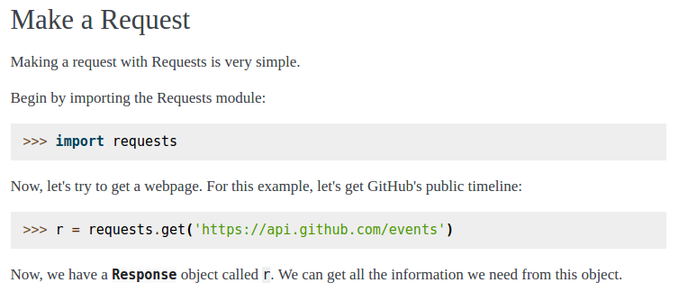
Let's see how can we implement the GET function.

Slide 25
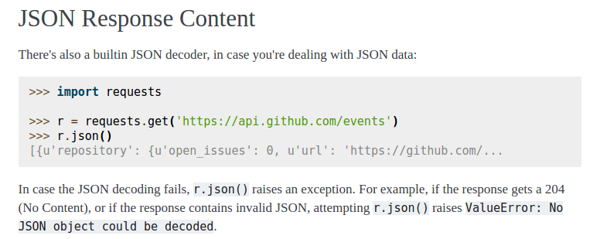
Making a GET request is easy. We just have to pass the URL as a parameter.
The requests library also consists of an inbuilt JSON decoder.

Slide 26
One thing that everyone needs to understand is that
If we use the API of an app, we don't need to remember any information or code whatsoever.
Every application has a developer page, which has the documentation for all the usage information of the API.
We can take a look at the Instagram's developers page.
https://www.instagram.com/developer/

Slide 27
How can we put the Instagram API to use?
To begin with, we need to have an Access Token.
What is an Access Token?
An access token is an opaque string that identifies a user, app, or page and can be used by the app to make graph API calls.
For a moment, let's assume our application to be a Hotel.
Now, everyone is allowed to roam around freely in the hotel public area.
But, how will you access your hotel room? Or the Gym? Or the Pool?
You reach out to the receptionist, share your credentials with her and get your Hotel key card.
Now this card gives you access to the restricted areas, like your room and the gym. And everytime you access any of these, the hotel authorities will know that it's you since your credentials are mapped to this card.

Slide 28
An Access Token is similar to the Hotel key card. Every developer is required to generate their own access token before he/she can access the various features of the API.
It is the Key to the API.
How do we get our Access Token?
To make your lives easy, we have made a Test Account on Instagram and an Access Token for it. You just have to send a GET Request using the Requests Library to get the Access Token.

Slide 29
An Access Token is similar to the Hotel key card. Every developer is required to generate their own access token before he/she can access the various features of the API.
It is the Key to the API.
How do we get our Access Token?
To make your lives easy, we have made a Test Account on Instagram and an Access Token for it. You just have to send a GET Request using the Requests Library to get the Access Token.
We are passing the URL as parameter in the get Function and using the JSON decoder. We have generated our own access token. What next?
response = requests.get('https://api.jsonbin.io/b/59d0f30408be13271f7df29c').json()
APP_ACCESS_TOKEN = response['access_token']

Slide 30
Introducing Endpoint
An Endpoint is just another word for URL.
An Endpoint usually has a constant URL part, called the Base URL.
For Instagram's API, the base url is : 'https://api.instagram.com/v1/'
The other important part of this URL is the Query String and Path.
Again, you don't need to memorize the path or anything as it is all there in the documentation of the API.

Slide 31
Before getting someone else's information through our bot, let's first get our own info.
For this we define a function self_info().
Let's have a look at the developer's guide and check out the steps to be followed to get our own information.

Slide 32
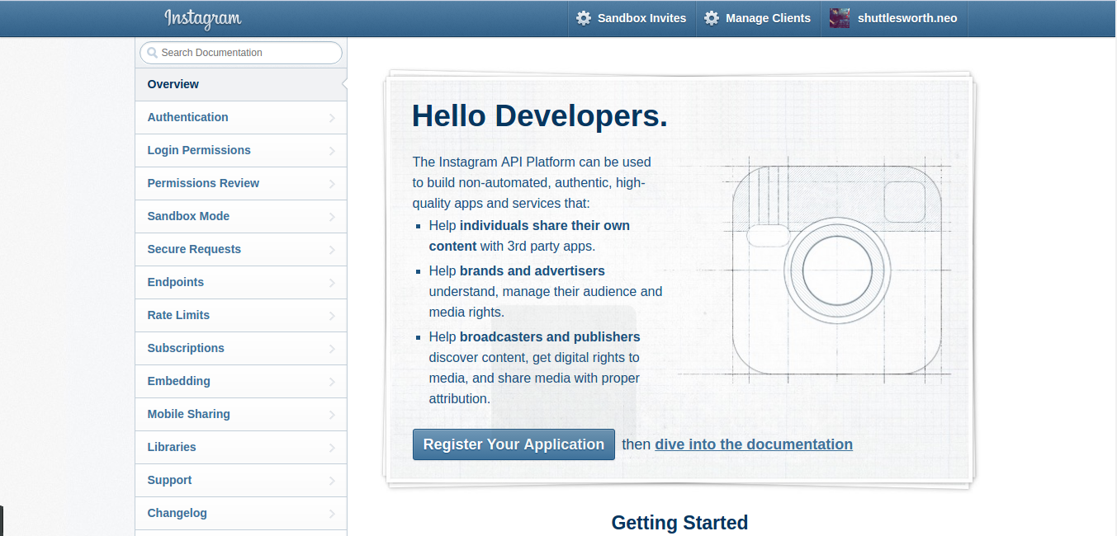

Slide 33
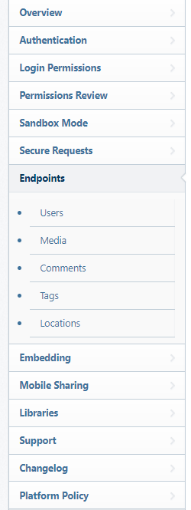
We start navigating the page for relevant information.
The Endpoint section here, provides us with the information for using the API for different tasks.

Slide 34
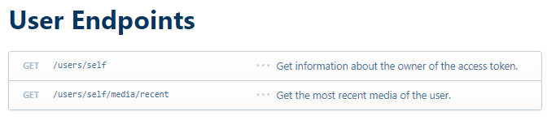
We navigate to the Users section as we have to get the user information.
As we can see here, there are 3 different columns.
The first column suggests the Request method to access Data.
The second column suggests the Path for making the Request.
The third column suggests the Function performed when the URL is passed through the suggested request method.

Slide 35
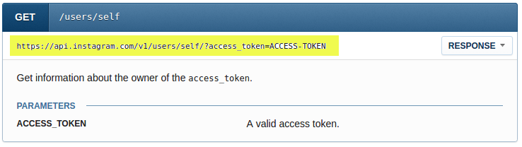
Since we need to get our own info, we checkout user/self path.
Look at the highlighted text, it gives us the url pattern.

Slide 36
For the given url pattern, https://api.instagram.com/v1/users/self/?access_token=ACCESS-TOKEN we can understand it as:
https://api.instagram.com/v1/ This is the base URL. It is common for all the Instagram API endpoints.
users/self/ This is the Path for the given functionality.
?access_token=ACCESS-TOKEN This is the Query List. It usually contains of the access token and ID for various attributes.

Slide 37
We have to make a GET request with the given URL pattern to get our own data. Let's write the code
def self_info():
request_url = (BASE_URL + 'users/self/?access_token=%s') %(APP_ACCESS_TOKEN)
print 'GET request url : %s' % (request_url)
user_info = requests.get(request_url).json()

Slide 38
Remember HTTP status codes?
Before we can proceed with printing the data we need to check if we have a proper response code of 200
def self_info():
request_url = (BASE_URL + 'users/self/?access_token=%s') %(APP_ACCESS_TOKEN)
print 'GET request url : %s' % (request_url)
user_info = requests.get(request_url).json()
if user_info['meta']['code'] == 200:
#Request successful
else:
print('Status code other than 200 received!')

Slide 39
Developer documentation also gives us an example of the response we can expect in the json:
{
"data": {
"id": "1574083",
"username": "snoopdogg",
"full_name": "Snoop Dogg",
"profile_picture": "http://distillery.s3.amazonaws.com/profiles/profile_1574083_75sq_1295469061.jpg",
"bio": "This is my bio",
"website": "http://snoopdogg.com",
"counts": {
"media": 1320,
"follows": 420,
"followed_by": 3410
}
}
}

Slide 40
The JSON response is similar to a dictionary that we used earlier and hence we can read data from it in a similar way that we used for the dictionary.
See if you can print the number of Followers, Posts and People we follow from the data received.

Slide 41
main.py
import requests
response = requests.get('https://api.jsonbin.io/b/59d0f30408be13271f7df29c').json()
APP_ACCESS_TOKEN = response['access_token']
BASE_URL='https://api.instagram.com/v1/'
def self_info():
request_url = (BASE_URL + 'users/self/?access_token=%s') % (APP_ACCESS_TOKEN)
print 'GET request url : %s' % (request_url)
user_info = requests.get(request_url).json()
if user_info['meta']['code'] == 200:
# Code to print user's details
else:
print('Status code other than 200 received!')
self_info()

Slide 42
That’s all for today’s class.
We’ll continue from the next class

